Slide 1
1/6 scale De Havilland aero engine
Modeled by: zach woffinden and Oscar Lopez

Slide 2
Interesting geometry

Slide 3
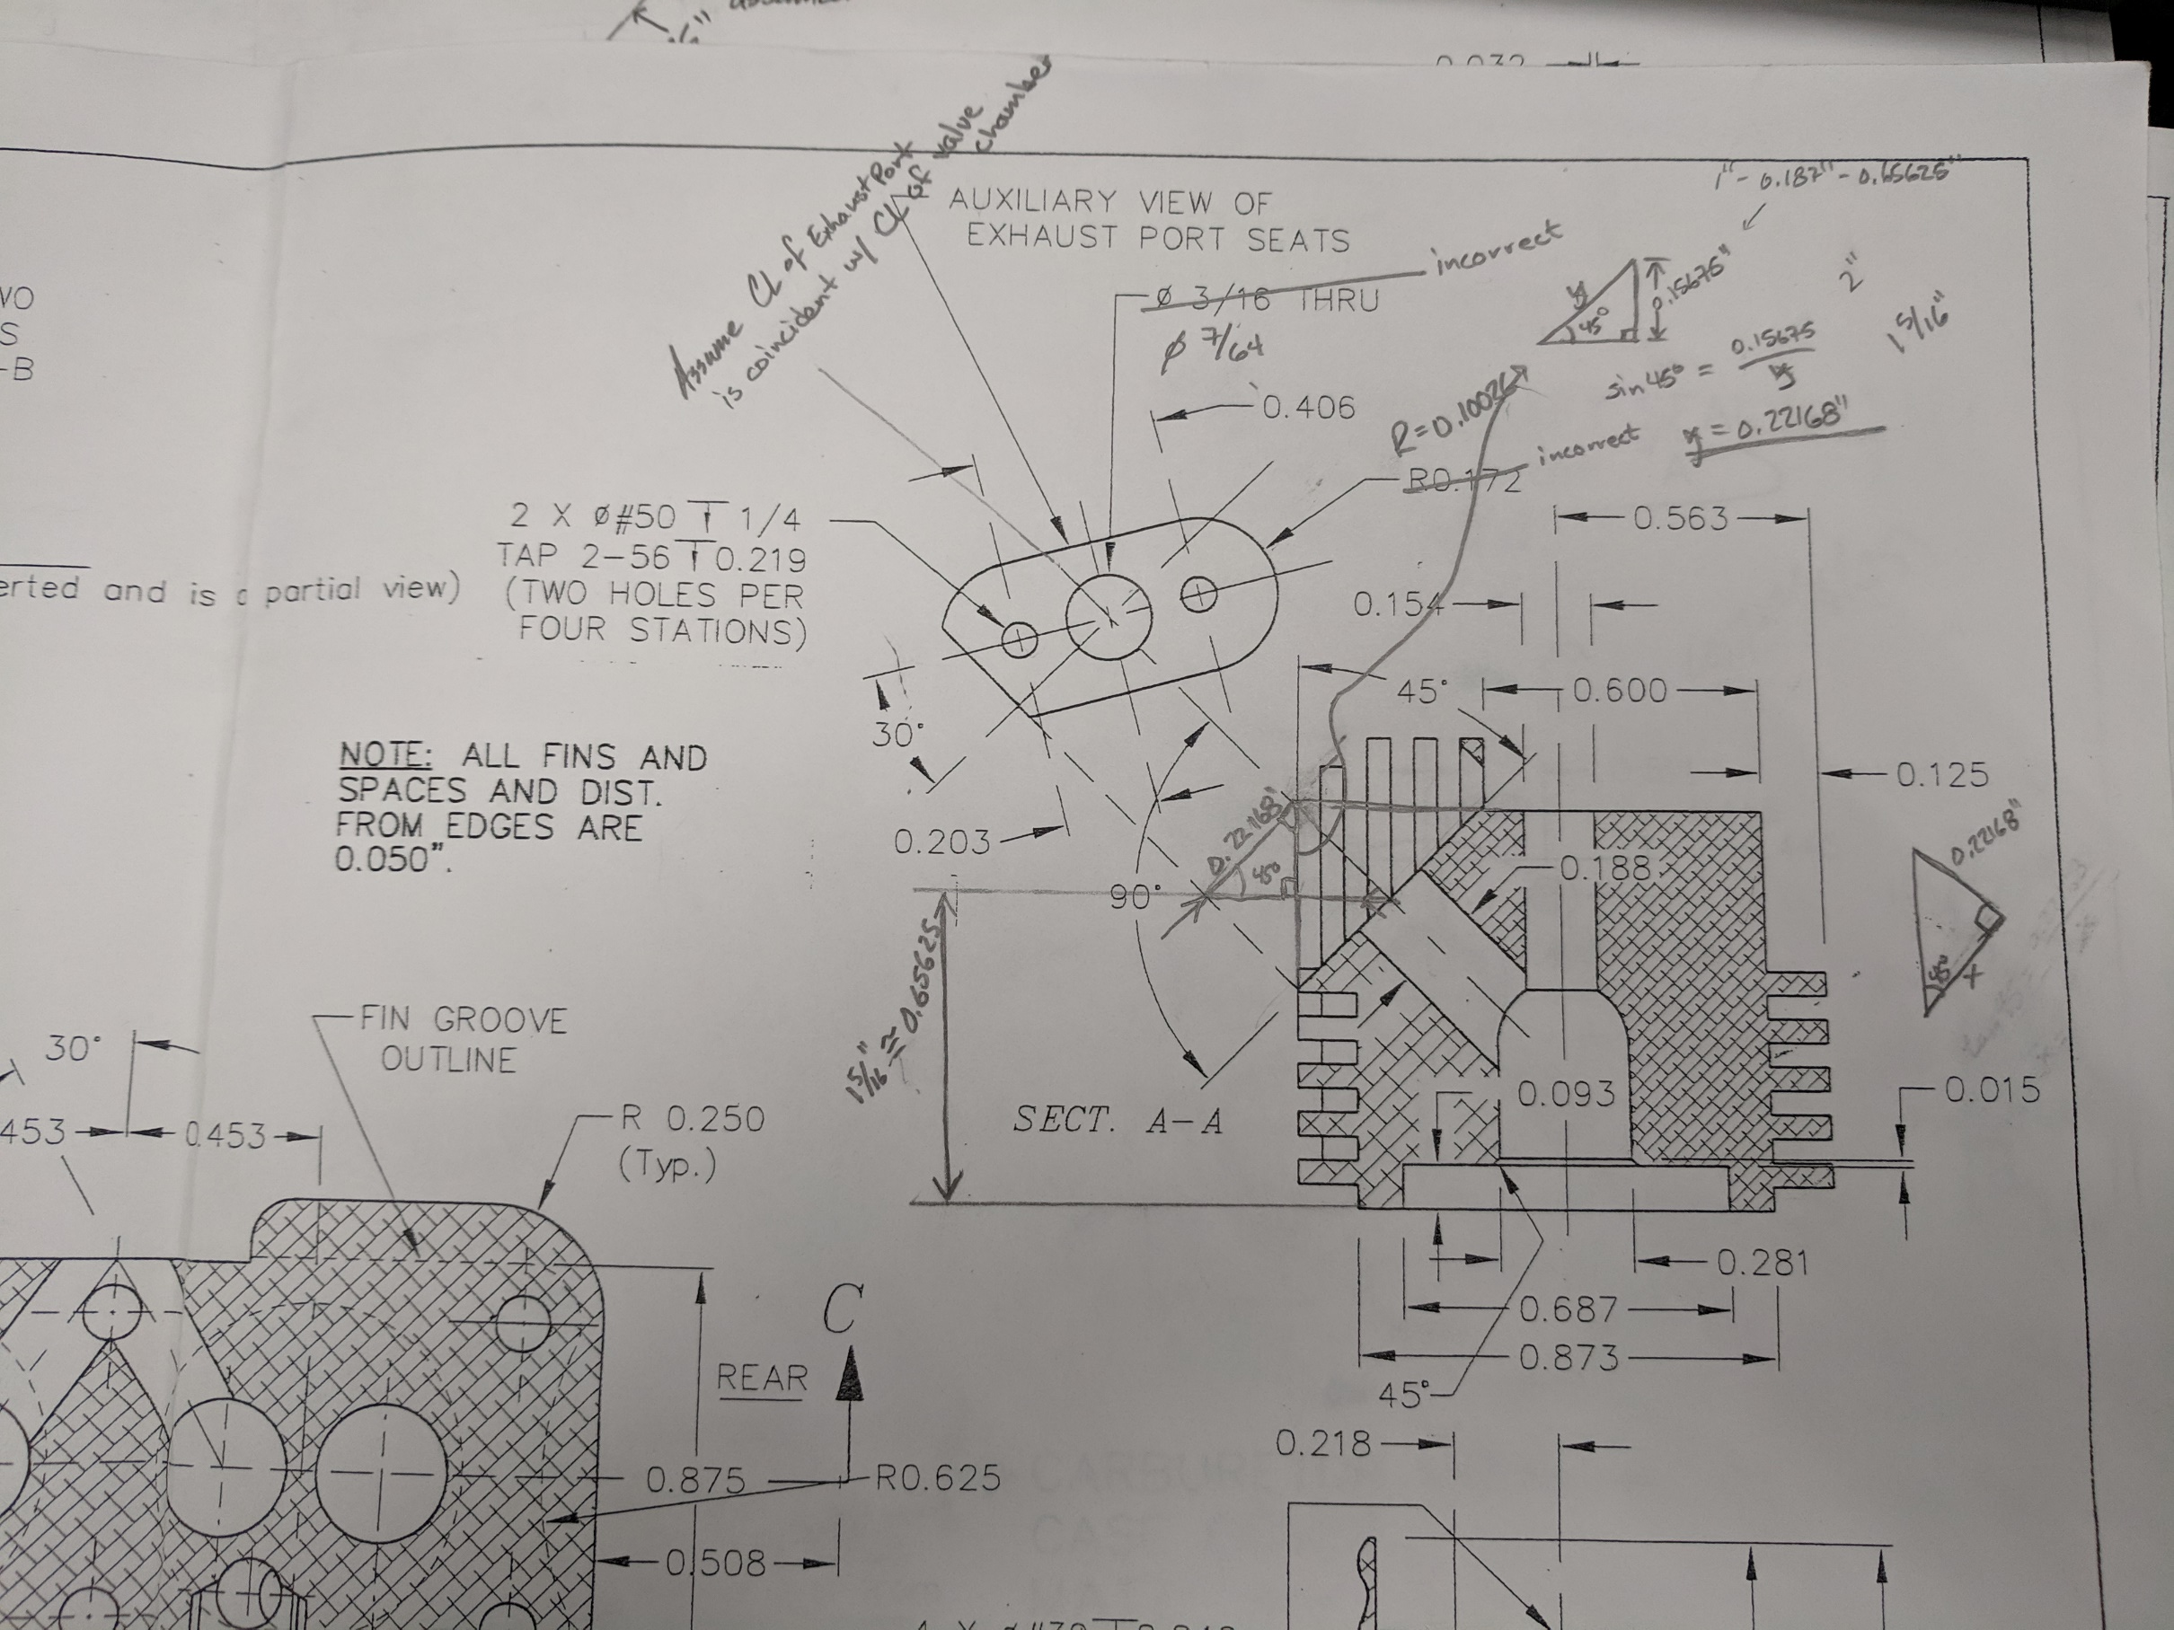
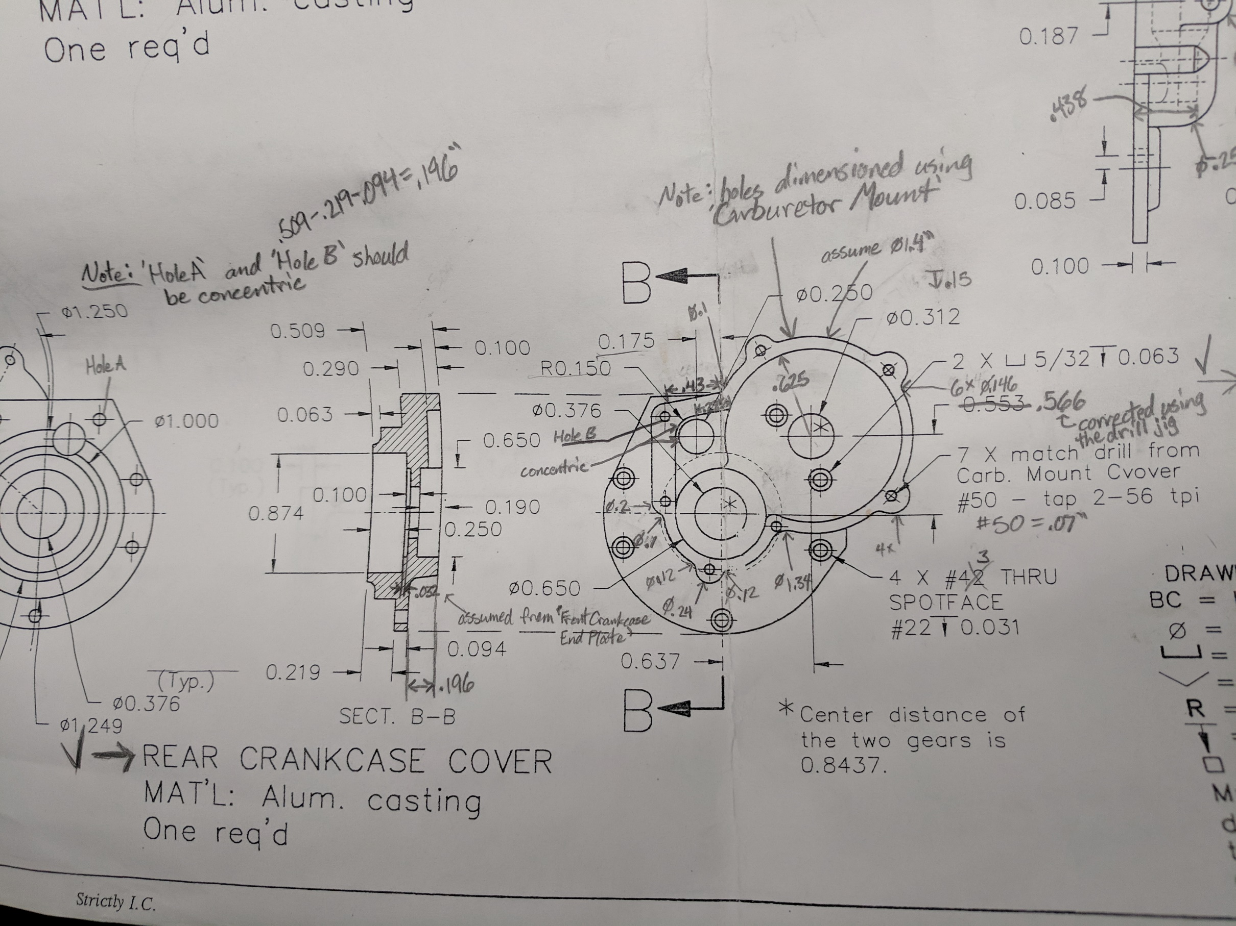
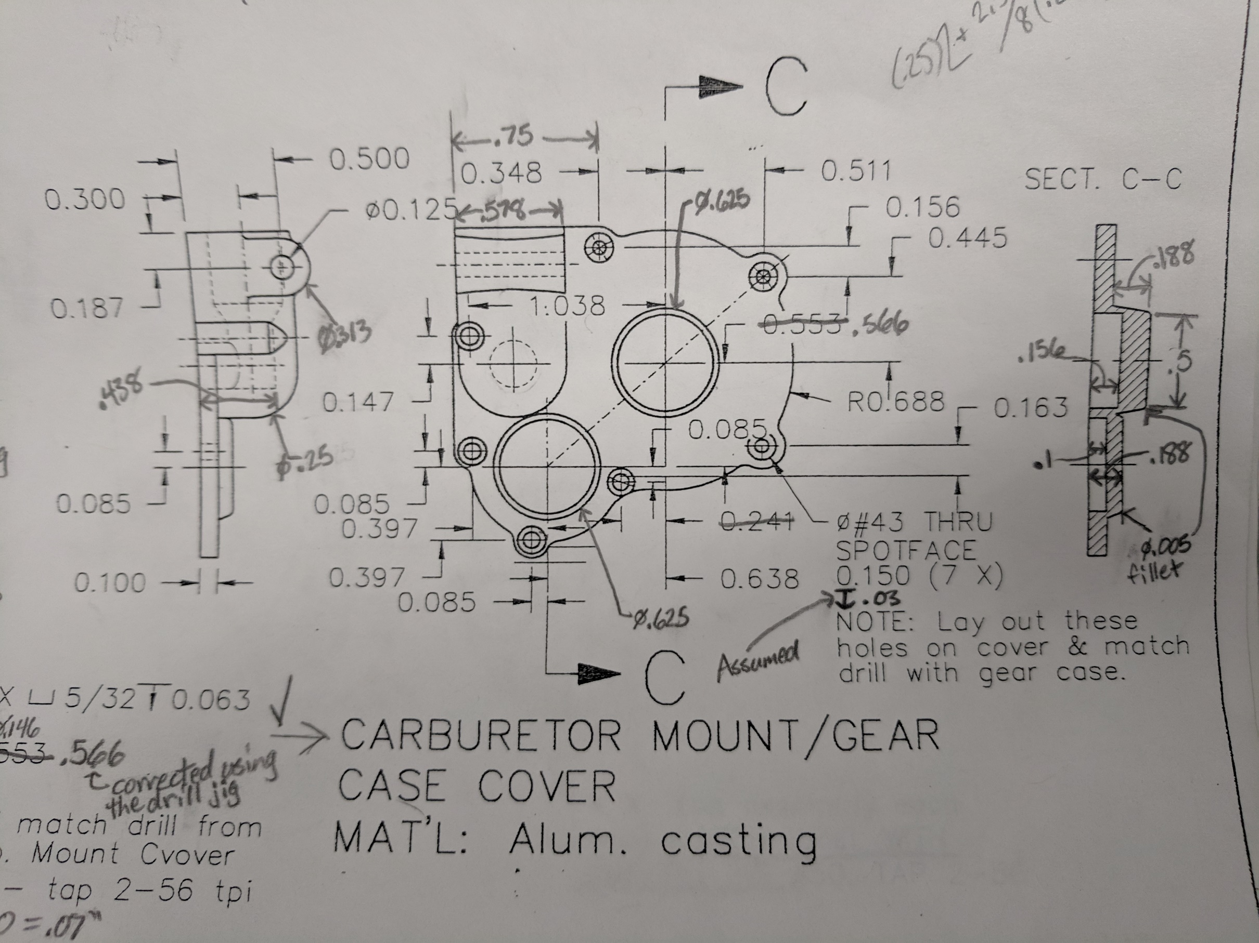
Assumptions/changes
100+ total assumptions and adjustments

